Slide 1

Secure
Procure
E-procurement for goods with robust decision support.
Team : Insp3ctors.
Coding4Integrity Hackathon

Slide 2
Procurement Process
Pre-selection
Tendering process
Evaluation
Post-selection
Coding4Integrity Hackathon

Slide 3
Solution
Pre-selection
Tendering process
Evaluation
Post-selection
Coding4Integrity Hackathon

Slide 4
Solution
Pre-selection
Tendering process
Evaluation
Post-selection
Users
Government agencies.
Suppliers / bidders.
Public.
Coding4Integrity Hackathon

Slide 5
Solution
Pre-selection
Tendering process
Evaluation
Post-selection
Open and publicly accessible web platform.
Documents’ verification at registration via API government integration.
Detailed RFPs of goods to facilitate evaluation.
Tamper-proof records of RFPs and bids via Blockchain.
Coding4Integrity Hackathon

Slide 6

Solution
Pre-selection
Tendering process
Evaluation
Post-selection
Coding4Integrity Hackathon

Slide 7
Solution
Pre-selection
Tendering process
Evaluation
Post-selection
Scoring of proposals based on RFPs’ criterias, companies’ profile and baseline prices using an AI model.
Reporting of potential abuse via other competitors / AI.
Coding4Integrity Hackathon

Slide 8
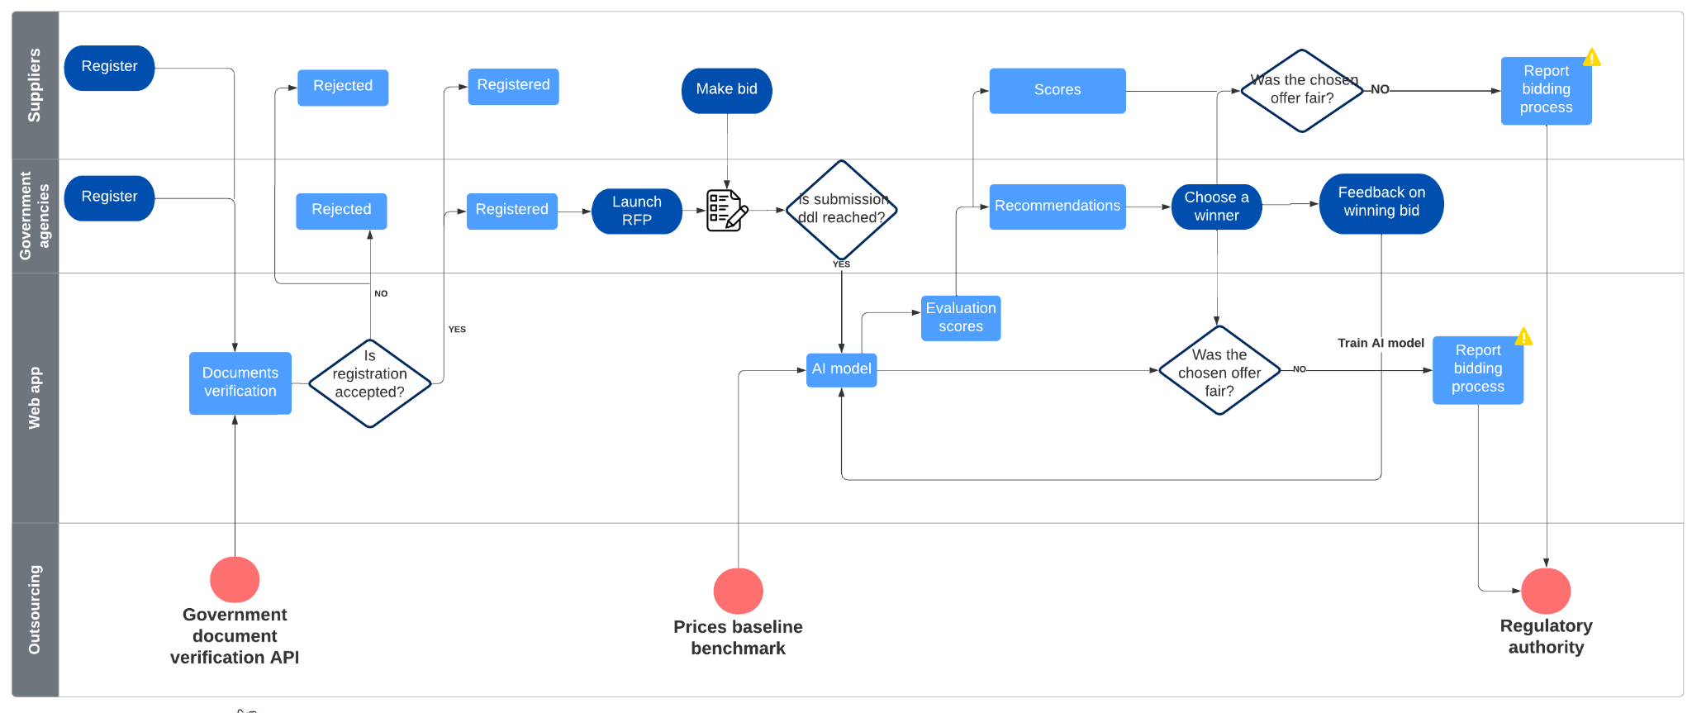
Workflow
Coding4Integrity Hackathon

Slide 9



Business model (B2B)
Limited to 2 submissions / month.
Annual subscription for unlimited submissions.
SME: 500$
Large Enterprises: 1000$
0.05% of winning proposal’s price.
Coding4Integrity Hackathon

Slide 10
Roadmap
Adapt a B2G strategy according to the regional and national government agencies.
Add services to the RFPs’ categories, instead of goods only.
Add a post-selection follow-up service, where monetary transactions are monitored with blockchain.
Coding4Integrity Hackathon

Slide 11
Demo
Coding4Integrity Hackathon

Slide 13
Thank you
Coding4Integrity Hackathon

Slide 14
Table of contents
01.
02.
03.
04.
Problem vs. solution
Product overview
You can describe the topic of the section here
You can describe the topic of the section here
Market & competition
Business model
You can describe the topic of the section here
You can describe the topic of the section here
Elegant Lines Pitch Deck // 2021

Slide 15
01.
Problem vs. solution
You can enter a subtitle here if you need it
Elegant Lines Pitch Deck // 2021

Slide 16

Our team
Jenna Doe
Tommy Lean
Susan Bones
You can speak a bit about this person here
You can speak a bit about this person here
You can speak a bit about this person here
Elegant Lines Pitch Deck // 2021

Slide 17
Our company
You can give a brief description of the topic you want to talk about here. For example, if you want to talk about Mercury, you can say that it’s the smallest planet in the entire Solar System
Elegant Lines Pitch Deck // 2021

Slide 18

Problem
Do you know what helps you make your point clear? Lists like this one:
They’re simple
You can organize your ideas clearly
You’ll never forget to buy milk!
And the most important thing: the audience won’t miss the point of your presentation
Elegant Lines Pitch Deck // 2021

Slide 19
Competitive advantage
Them
Us
Mercury is the closest planet to the Sun and the smallest one in the Solar System—it’s only a bit larger than the Moon
Venus has a beautiful name and is the second planet from the Sun. It’s hot and has a poisonous atmosphere
Elegant Lines Pitch Deck // 2021

Slide 20
SWOT analysis
Strengths
Opportunities
Weaknesses
Threats
S
O
Venus is the second planet from the Sun
Jupiter is the biggest planet of them all
W
T
Despite being red, Mars is a cold place
Saturn is a gas giant and has several rings
Elegant Lines Pitch Deck // 2021

Slide 21
Evaluation
Define Evaluation Criteria and Weighting
Establish an evaluation using our AI model
Recommendation and Approval
Elegant Lines Pitch Deck // 2021

Slide 22

Solution
Venus has a beautiful name and is the second planet from the Sun. It’s terribly hot, even hotter than Mercury, and its atmosphere is extremely poisonous. It’s the second-brightest natural object in the night sky after the Moon
Mercury is the closest planet to the Sun and the smallest one in the Solar System. This planet's name has nothing to do with the liquid metal, since Mercury was named after the Roman messenger god
Elegant Lines Pitch Deck // 2021

Slide 23
Our plans
Pro
Basic
Premium
Venus has a beautiful name and is the second planet from the Sun
Mercury is the closest planet to the Sun and the smallest of them all
Despite being red, Mars is actually a cold place. It’s full of iron oxide dust
Elegant Lines Pitch Deck // 2021

Slide 24
—Someone Famous
“This is a quote, words full of wisdom that someone important said and can make the reader get inspired.”
Elegant Lines Pitch Deck // 2021

Slide 25
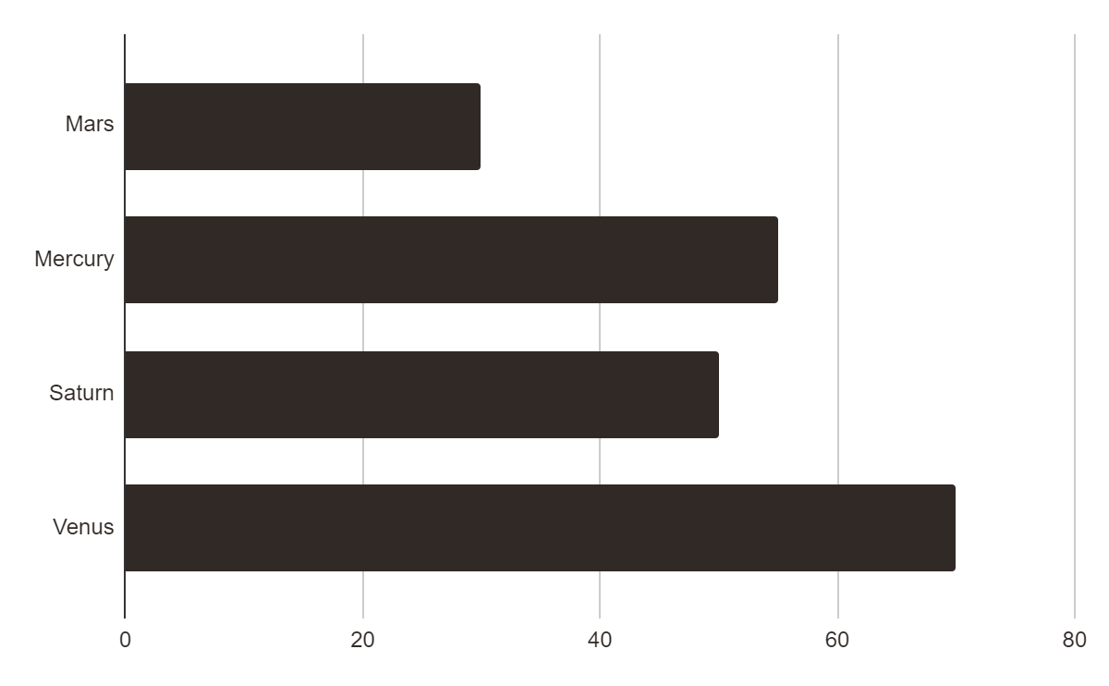
Traction
Mercury is the closest planet to the Sun and the smallest one in the Solar System—it’s only a bit larger than the Moon
Follow the link in the graph to modify its data and then paste the new one here. For more info, click here
Elegant Lines Pitch Deck // 2021

Slide 26
Reviews
Nicole Wills
Ron Smith
Isaac Berger
Despite being red, Mars is a cold place. It’s full of iron oxide dust, which gives the planet its reddish cast
Mercury is the closest planet to the Sun and the smallest one in the Solar System—it’s only a bit larger than the Moon
Venus has a beautiful name and is the second planet from the Sun. It’s terribly hot—even hotter than Mercury
Elegant Lines Pitch Deck // 2021

Slide 27
Case study
Case study
Challenge
Results
Solution
Despite being red, Mars is a very cold place
Jupiter is the biggest planet of them all
Venus is the second planet from the Sun
Elegant Lines Pitch Deck // 2021

Slide 28
Market size
10%
27%
42%
Mercury
Venus
Mars
Mercury is the closest planet to the Sun
Venus is the second planet from the Sun
Despite being red, Mars is a cold place
Elegant Lines Pitch Deck // 2021

Slide 29
Target
Age
Hobbies
10%
50%
40%
16 - 20
21 - 30
31 - 40
Gender
Women
Men
Elegant Lines Pitch Deck // 2021

Slide 30
Competitors
 | Mercury | Venus | Mars
Competitor 1
Competitor 2
Competitor 3
Competitor 4
Competitor 5
Elegant Lines Pitch Deck // 2021

Slide 31
Awards
Venus
Saturn
Mars
Neptune
Venus is the second planet from the Sun
Saturn is composed of hydrogen and helium
Mars is actually a very cold place
It’s the farthest planet from the Sun
Elegant Lines Pitch Deck // 2021

Slide 32
Timing
Jupiter is the biggest planet
Saturn is the ringed planet
Mars is a very cold place
Phase 1
Phase 2
Phase 3
Phase 6
Phase 5
Phase 4
Mercury is the smallest planet
We all live on planet Earth
Venus has a beautiful name
Elegant Lines Pitch Deck // 2021

Slide 33

A picture always reinforces the concept
Images reveal large amounts of data, so remember: use an image instead of a long text. Your audience will appreciate it
Elegant Lines Pitch Deck // 2021

Slide 34

A picture is worth a thousand words
Elegant Lines Pitch Deck // 2021

Slide 35
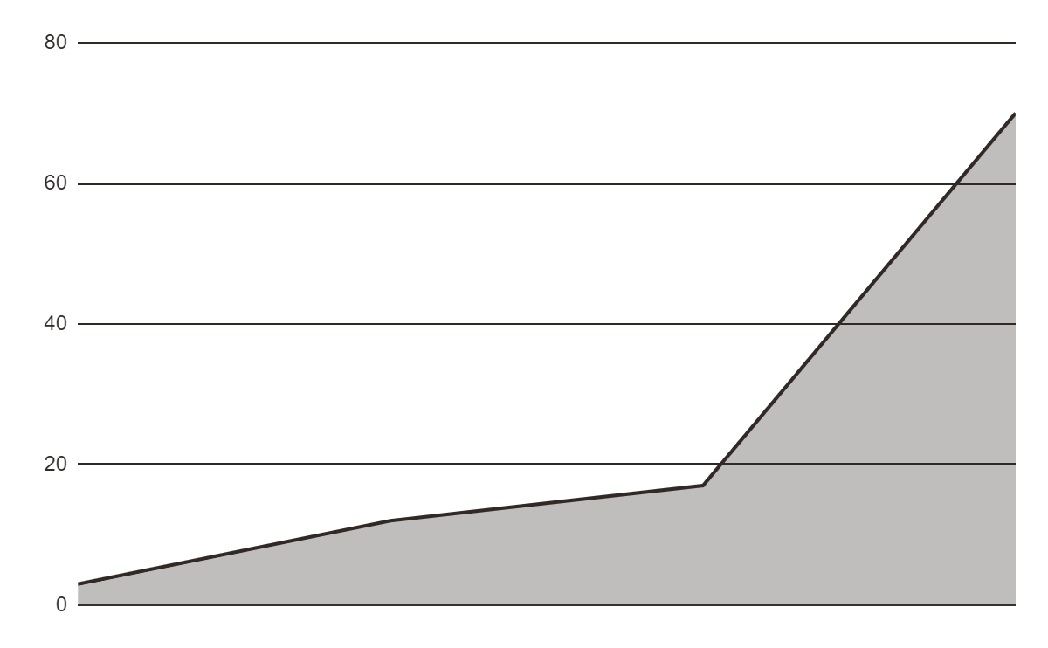
Predicted growth
+1K
Increase in downloads 2020-2024
+2,500
Increase in user loyalty 2020-2024
Follow the link in the graph to modify its data and then paste the new one here. For more info, click here
Elegant Lines Pitch Deck // 2021

Slide 36
150,000
Big numbers catch your audience’s attention
Elegant Lines Pitch Deck // 2021

Slide 37
9h 55m 23s
333,000.000
386,000 km
Jupiter's rotation period
The Sun’s mass compared to Earth’s
Distance between Earth and the Moon
Elegant Lines Pitch Deck // 2021

Slide 38
Awesome words
Elegant Lines Pitch Deck // 2021

Slide 39
Alternative resources
Here’s an assortment of alternative resources whose style fits that of this template
Photos
Portrait young businesswoman with tablet
Coworkers having a work meeting at the office
Side view man doing a presentation during a meeting
Men analyzing a graph together at work
Employees in business meeting
Medium shot business woman with post its
Man having a videocall for work
Businesswoman having an online meeting
Elegant Lines Pitch Deck // 2021

Slide 40
Resources
Did you like the resources on this template? Get them for free at our other websites:
Vector:
Minimalist business card pack
Photos
Top view person writing on laptop with copy space
Young businesswoman checking her tablet with copy space
Business man working late at the office
Business man working late at the office
Coworkers having a work meeting
People discussing business medium shot
Elegant Lines Pitch Deck // 2021

Slide 41
Instructions for use
In order to use this template, you must credit Slidesgo by keeping the Thanks slide.
You are allowed to:
- Modify this template.
- Use it for both personal and commercial projects.
You are not allowed to:
- Sublicense, sell or rent any of Slidesgo Content (or a modified version of Slidesgo Content).
- Distribute Slidesgo Content unless it has been expressly authorized by Slidesgo.
- Include Slidesgo Content in an online or offline database or file.
- Offer Slidesgo templates (or modified versions of Slidesgo templates) for download.
- Acquire the copyright of Slidesgo Content.
For more information about editing slides, please read our FAQs or visit Slidesgo School:
https://slidesgo.com/faqs and https://slidesgo.com/slidesgo-school

Slide 42
Instructions for use (premium users)
As a Premium user, you can use this template without attributing Slidesgo or keeping the "Thanks" slide.
You are allowed to:
Modify this template.
Use it for both personal and commercial purposes.
Hide or delete the “Thanks” slide and the mention to Slidesgo in the credits.
Share this template in an editable format with people who are not part of your team.
You are not allowed to:
Sublicense, sell or rent this Slidesgo Template (or a modified version of this Slidesgo Template).
Distribute this Slidesgo Template (or a modified version of this Slidesgo Template) or include it in a database or in any other product or service that offers downloadable images, icons or presentations that may be subject to distribution or resale.
Use any of the elements that are part of this Slidesgo Template in an isolated and separated way from this Template.
Register any of the elements that are part of this template as a trademark or logo, or register it as a work in an intellectual property registry or similar.
For more information about editing slides, please read our FAQs or visit Slidesgo School:
https://slidesgo.com/faqs and https://slidesgo.com/slidesgo-school

Slide 43
Fonts & colors used
This presentation has been made using the following fonts:
Abril Fatface
(https://fonts.google.com/specimen/Abril+Fatface)
Nunito
(https://fonts.google.com/specimen/Nunito)
#302926
#e7e7e7

Slide 44





Storyset
Create your Story with our illustrated concepts. Choose the style you like the most, edit its colors, pick the background and layers you want to show and bring them to life with the animator panel! It will boost your presentation. Check out How it Works.
Pana
Amico
Bro
Rafiki
Cuate

Slide 45
Use our editable graphic resources...
You can easily resize these resources without losing quality. To change the color, just ungroup the resource and click on the object you want to change. Then, click on the paint bucket and select the color you want. Group the resource again when you’re done. You can also look for more infographics on Slidesgo.

Slide 48
JANUARY
FEBRUARY
MARCH
APRIL
MAY
JUNE
PHASE 1
Task 1
Task 2
PHASE 2
Task 1
Task 2
JANUARY
FEBRUARY
MARCH
APRIL
PHASE 1
Task 1
Task 2

Slide 51
...and our sets of editable icons
You can resize these icons without losing quality.
You can change the stroke and fill color; just select the icon and click on the paint bucket/pen.
In Google Slides, you can also use Flaticon’s extension, allowing you to customize and add even more icons.

Slide 52
Educational Icons
Medical Icons

Slide 53
Business Icons
Teamwork Icons

Slide 54
Help & Support Icons
Avatar Icons

Slide 55
Creative Process Icons
Performing Arts Icons

Slide 56
Nature Icons

Slide 57
SEO & Marketing Icons

Slide 58


